Slide 1
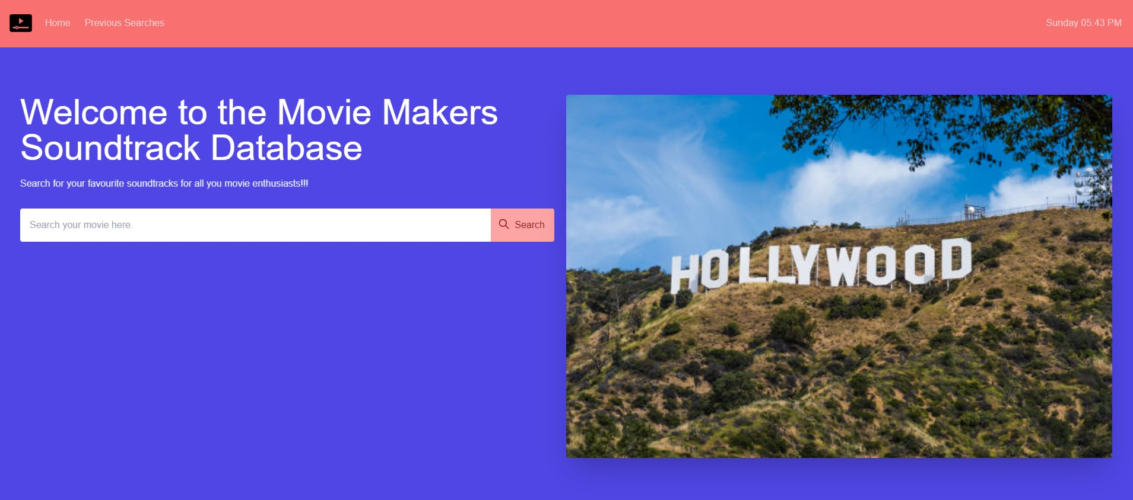
Movie Makers Soundtrack Database

Slide 2
Pitch
Have you ever been to a movie and thought this soundtrack is amazing, but I wish I knew how to find it?
A lot of movie databases only give you information about the movie but not the music
Our database provides a link between the Movie and the Soundtrack

Slide 3
Concept
This project was created so people who have a passion for music in movies to be able to search for their favourite soundtracks.
This website was developed to be able to practice working with other collabarators and to further enhance our skills in Html, Javascript and CS
User Story
As a movie and music enthusiast I want to search movie titles so that I can receive information the year it was released, poster and soundtrack.

Slide 4
Process
Technologies used were Tailwind CSS, HTML, Javascript, DAY JS
Breakdown of tasks and roles
Search History
Debugging,
Modals,
Javascript,
Applying CSS,
Readme
Project lead, Developers
The challenges
Syntax,
Debugging,
How to navigate through APIs,
Javascript language,
Successes
Cleaning those bugs.
Produce a working Website/app
Splitting up tasks
Working well together
Working together as a team everyday
Open and talk through things

Slide 5
Demo

Slide 6
Future Development
Movie and Music News
Awards
Social and Forum
Login & sign up page

Slide 7
Links
https://breakfireaus.github.io/Movie-and-music-database/
https://github.com/breakfireaus/Movie-and-music-database.git

